Slide 1
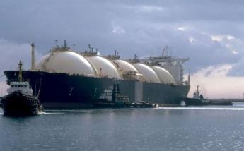
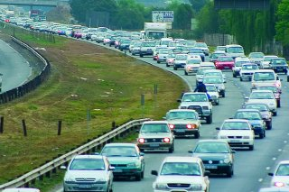
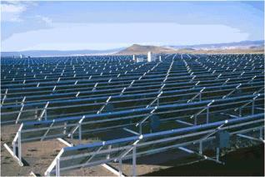

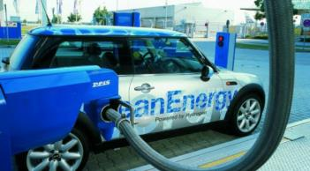
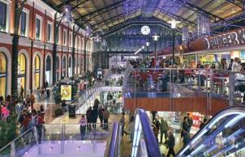
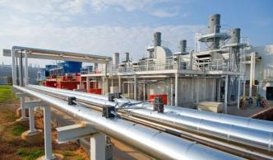
An Overview of the SA TIMES Model SATIM
Bruno Merven
September 2016

Slide 2
SATIM – Key Points
South African TIMES Model (SATIM)
Partial equilibrium linear optimisation model capable of representing the whole energy system, including its economic costs and its emissions.
A number of years of development - 2003 IEP, 2007 LTMS, 2011 LEP -> current version
Methodology, Assumptions and Models in the public domain: http://energydata.uct.ac.za
https://ercviz.shinyapps.io/gdxplore/ (beta version of results vizualisation)
TIMES code is Open Source and has an active development community (IEA-ETSAP)!

Slide 3
SATIM: Main Features
Bottom-up Energy Systems Optimization Long-Range (>10 years) Planning Model (similar to the one used for the IEP)
Full Sector: Includes and allows trade-off between demand and Supply
End-use type model:
Gives a detailed description of how the energy is used.
Describes the types of equipment used and how much energy is used by each type of equipment to satisfy demand.
Can be used to forecast useful energy as well as final energy demand
Allows for exploration of policy impacts (via constraints/targets, subsidies and taxes)
Can capture:
structural changes/ shocks
mode switching (transport)
fuel switching
Technical improvement/ improved efficiency
Intensity changes e.g. mines have to dig deeper

Slide 4
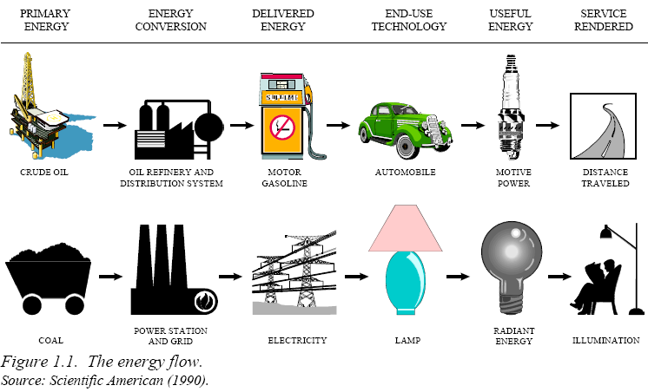
The Full Energy Chain is Characterised

Slide 5
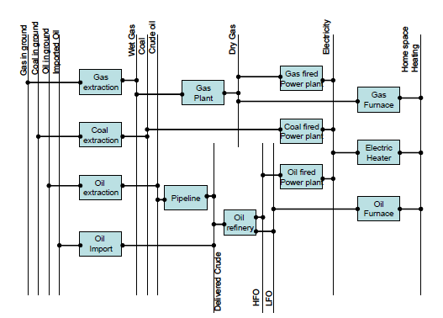
Simple Reference Energy System

Slide 6
Overview of SATIM and data needs
Objective function = minimize sum of total discounted costs over planning horizon
Given constraints and other system parameters (cost, efficiency, load curves, etc.)
Energy Resources/Import and Exports
Demand Sectors (commercial and agriculture omitted from diagram)
Import/export (elc, oil, gas)
Renewable energy resource potential
Fossil fuel reserves
Base Year Energy Balance
Residential sector future technologies
Industrial sector future technologies
Transport sector future technologies
MARKAL/TIMES optimization energy model (GAMS with CPLEX solver)
Supply Technology
Residential sector base-year calibration
Industrial sector base-year calibration
Transport sector base-year calibration
Future coal/gas supply technologies
Future liquid fuel supply technologies
Future power generation technologies
Residential sector Demand projections
Industrial sector Demand projections
Transport sector Demand projections
Existing coal/gas supply system
Existing liquid fuel supply system
Existing power system
Economic Analysis
Policy objectives/constraints
Socio-Economic Variables (GDP, Population)
Energy security objectives
Environmental objectives, taxes
Socio-economic growth objectives
Results Analysis
Investment Schedule/Plan
Imports, exports, consumption, production, Emissions
System costs, energy costs
Inputs to optimization model
Outputs from optimization model
Intermediary information flow

Slide 7
Sectors
Sector | Disaggregation | Driver
Agriculture | By end use: irrigation, transport etc | Agriculture GDP
Residential | High, medium and low income/ electrified and non-electrified | Population, Household income, electrification
 | By end use: cooking, lighting etc
Commercial | By end use: lighting, HVAC, etc | Commercial GDP, building stock
Industrial | By sector: Iron and Steel, Pulp and paper etc | Sectoral Value Added or Output
 | By end use: thermal fuel or electricity (compressed air, cooling, motive, etc
Transport | By Sector: Air, Freight, Passenger, Pipeline | Transport GDP, Population and household income
 | By end use - Freight: rail, road (light, medium, heavy)
 | By end use – Passenger: Cars, SUV, bus, etc…

Slide 8
Variation of the Load (electricity)
Default: 20 Time-slices
Year divided in 3 seasons
Each season represented by 2 typical days
Season 1 and 3 (summer), each day is broken up into 3 parts (night, day, evening)
Season 2 (winter) week day is broken up into 5 parts (night, morning, afternoon, evening, peak)

Slide 9
Current Projects

Slide 10
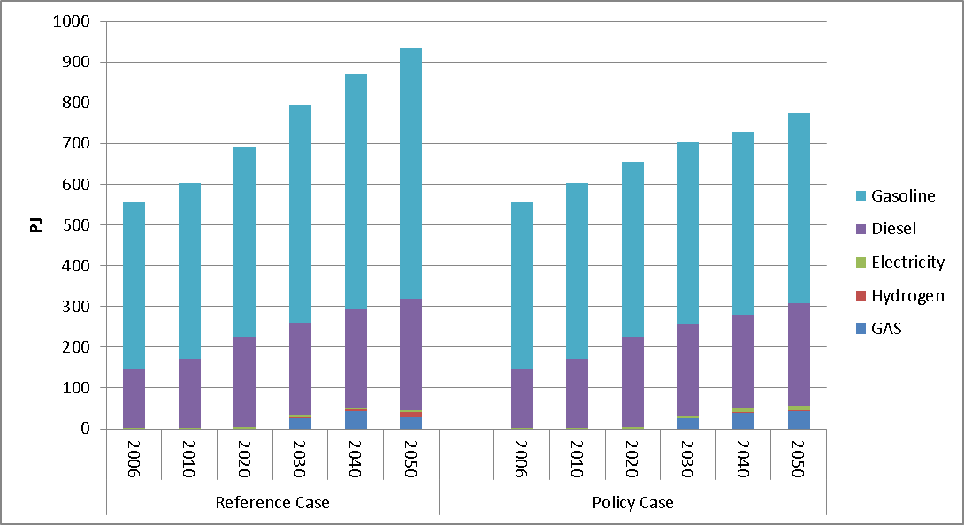
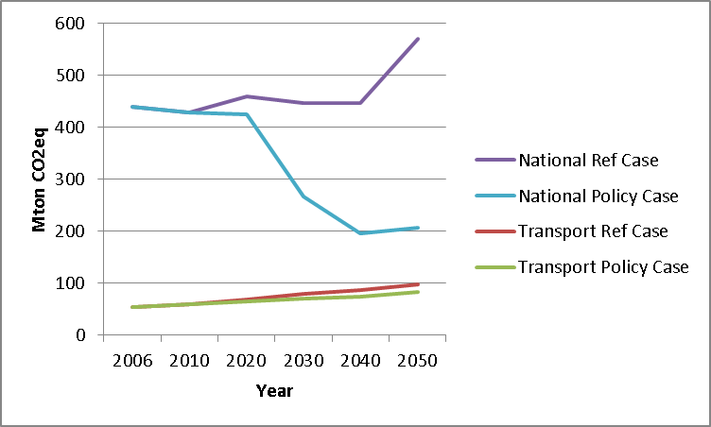
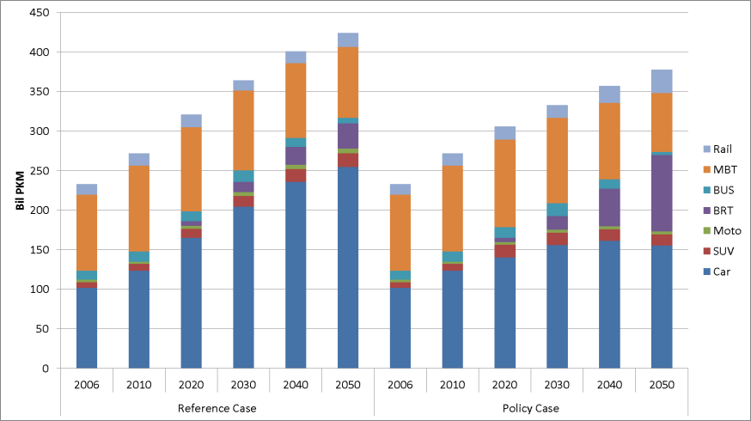
Project: Transport Study Phase 2 Scope: National E3 focus on transport (and upstream) policies Focus: Transport Funders: DST via SANEDI

Slide 11
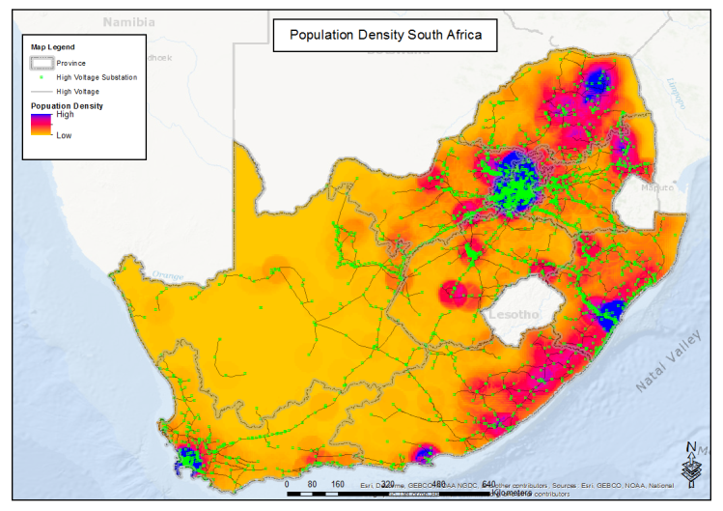
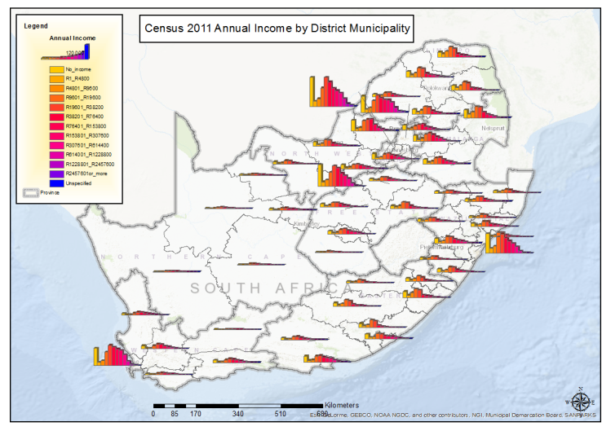
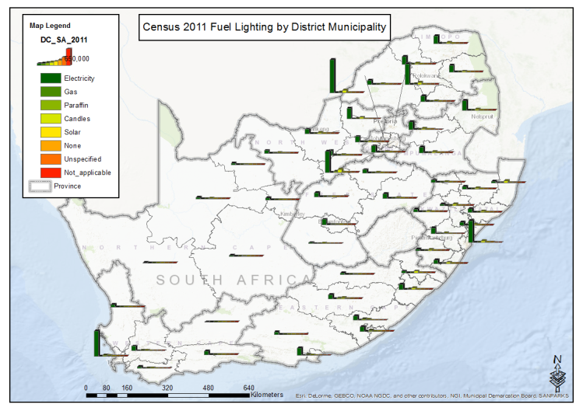
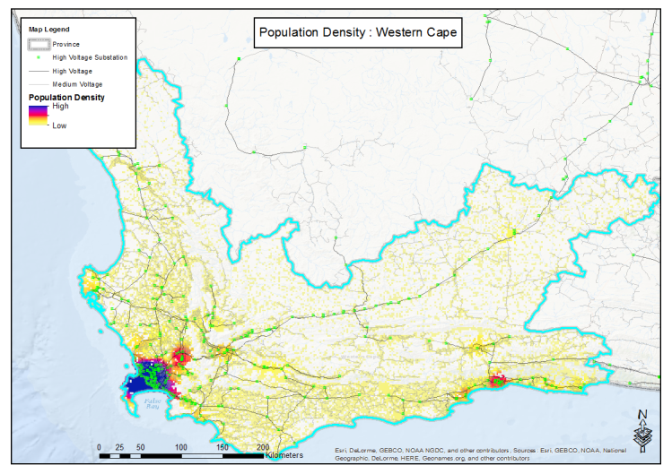
Project: Fuel Switching Project Scope: National E3 Focus: focus on transmission and distribution parameters and spatial aspects of demand Funders: DST via SANEDI

Slide 12
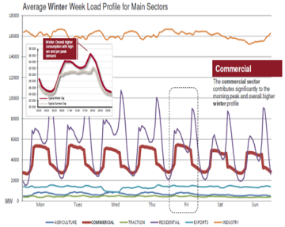
Flexible Demand Project: Overall
Project: Flexible Demand Project Scope: National E3 Focus: focus on time of use of electricity Funders: DST via SANEDI
Pre-Winter
Winter
Post-Winter

Slide 13
Flexible Demand Project: Industry

Slide 14
Flexible Demand Project: Residential

Slide 15
Flexible Demand: Commerce

Slide 16
Link to Economy-wide model
Energy/Climate Policy
GDP
Household income
Price indices
EN
EC
Technology Mix
GDP
Welfare
Employment
Electricity Price
Electricity Production function
Expenditure on expansion plan
Production function of all activities (energy)
Consumption function of households (energy)

Slide 17
Project: Energy Data Portal Focus: Energy Data Funders: DST via SANEDI
CKAN (Open Knowledge Foundation)
Free, open source and maintained
Community based and access controlled
International state of the art, including linked data and research citations (DOI referencing)
Flexible and reproducible
https://energydata.uct.ac.za, https://ercviz.shinyapps.io/gdxplore/ (beta version)

Slide 18
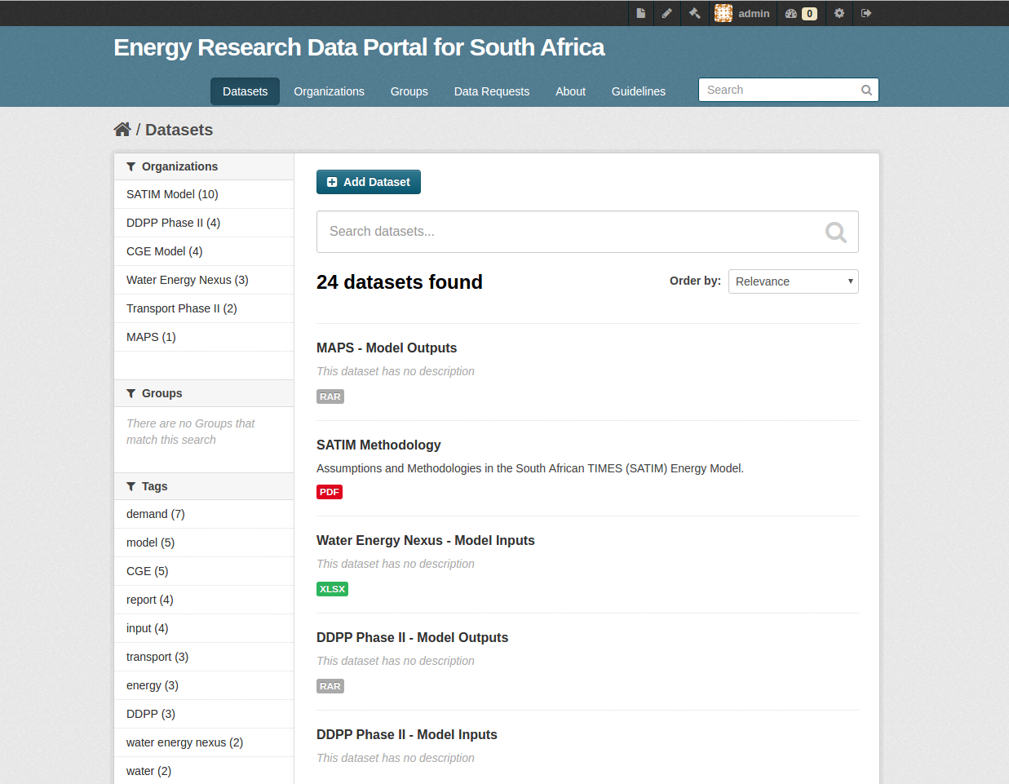

Slide 19
Data Objectives
Immediate / temporary
Future
Establish a data culture at the ERC
Share input data and information
Make ERC energy models easily accessible
Improve version control and model reproducibility
Pilot and feedback
Create a data community around energy modeling
Establish a model data archive to feed into future data portals
Provide data visualisations
Close the gap from modeling to decision making

Slide 20
Recent Projects

Slide 21
Project: Deep Decarbonisation Development Pathways (DDPP) Scope: National E3 Focus: Climate Change, Economy, Social Funders: IDDRI, CIFF Collaborators: ERC-E2C2
Cumulative CO2 Constraint
EN
CO2 Trajectory
for Power Sector
(soft link)
GDP
Household Income
(soft link)
Electricity Demand
EN-el
EC
Power Plant Mix
GDP
Welfare
Employment
High intensity
Electricity Price
Electricity Production function
Expenditure on expansion plan
B
High skill
Low skill
(Altieri et al. 2016)
C
D
Low intensity

Slide 22
Project: Deep Decarbonisation Development Pathways (DDPP) Scope: National E3 Focus: Climate Change, Economy, Social Funders: IDDRI, CIFF Collaborators: ERC-E2C2

Slide 23
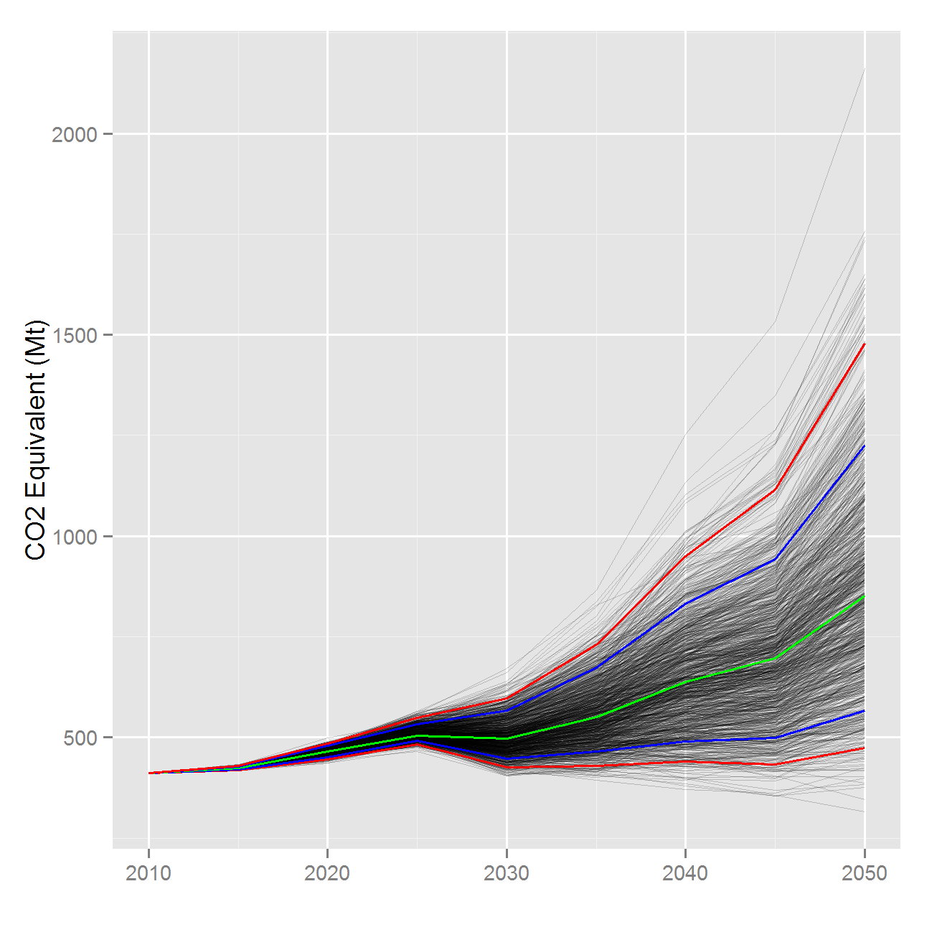
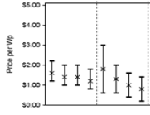
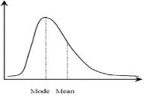
Project: Uncertainty in baseline GHG emissions for SA Scope: National E3 Focus: GHG emissions in a “No Climate Policy” Scenario + Methodology Funders: UNEP
GDP & Population
Fuels Prices
SA TIMES energy model
Least cost energy mix
Technology Costs
GHG Emissions Projection
UNCERTAINTY
Monte Carlo algorithm
SA TIMES Model
(SATIM)
Expert Elicitation
Combined Elicited Distributions

Slide 24
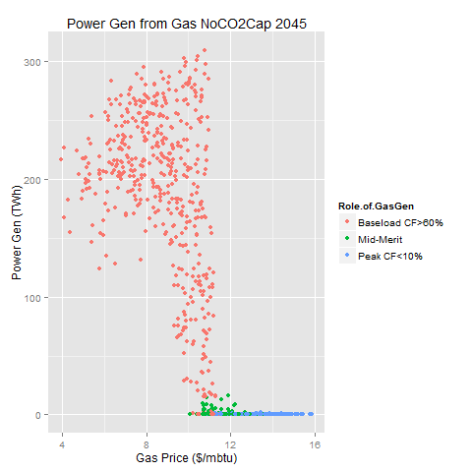
Project: Potential Role of Natural Gas in SA Scope: National E3 Focus: Natural Gas demand and supply Funders: FCO, ERC
Without a GHG constraint, very limited role for gas above a gas price of USD11/Mbtu
Significant variation in uptake driven by different GDP growth rates
Notes:
Uncertainty analysis of GDP growth, technology costs, fuel costs
GHG unconstrained and constrained scenarios
1000 model runs to test the impact of uncertainty – which are the critical factors which make a difference?
Using a full systems model picks up on interesting systemic effects - e.g. the use of natural gas as a transport fuel rather than GTL

Slide 25
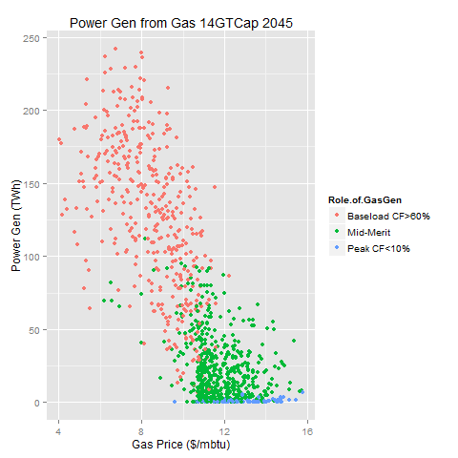
Project: Potential Role of Natural Gas in SA Scope: National E3 Focus: Natural Gas demand and supply Funders: FCO, ERC
With a GHG constraint,a much more diversified role for gas above USD11/Mbtu
Smaller range of uptake due to the GHG constraint – less response to GDP growth

Slide 26
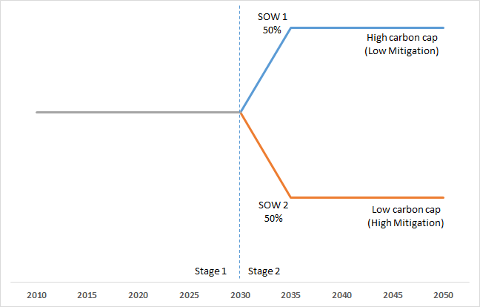
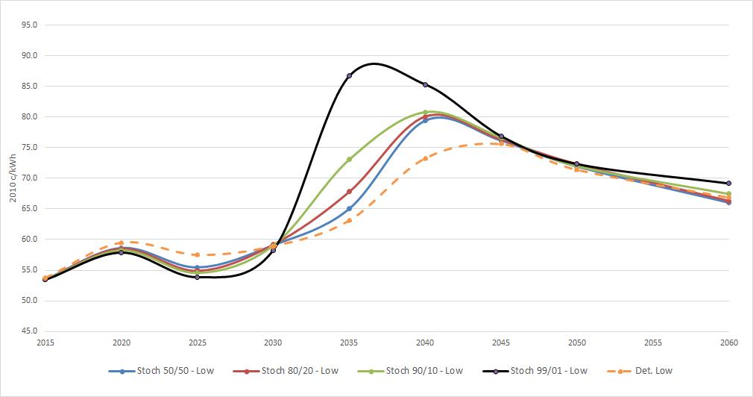
Project: Stochastic Programming: Uncertainty on CO2 Constraint Scope: National E3 Focus: CO2 emissions, impact on Electricity Price+Methodology Funders: CIFF via MAPS

Slide 27
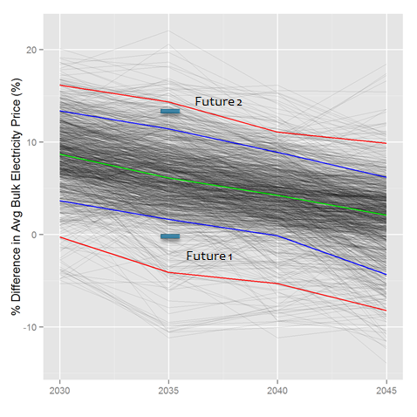
Project: Socioeconomic Implications of SA’s Nuclear Build Plan Scope: National E3 Focus: Electricity, Socio-economics Funders: ELA
In 2030
Future 1: Sustained electricity price increase
~R400bn additional electricity sector investment requirement
Job and welfare threats
Future 2: No electricity price increase
Opportunities for growth from over supply of electricity

Slide 28
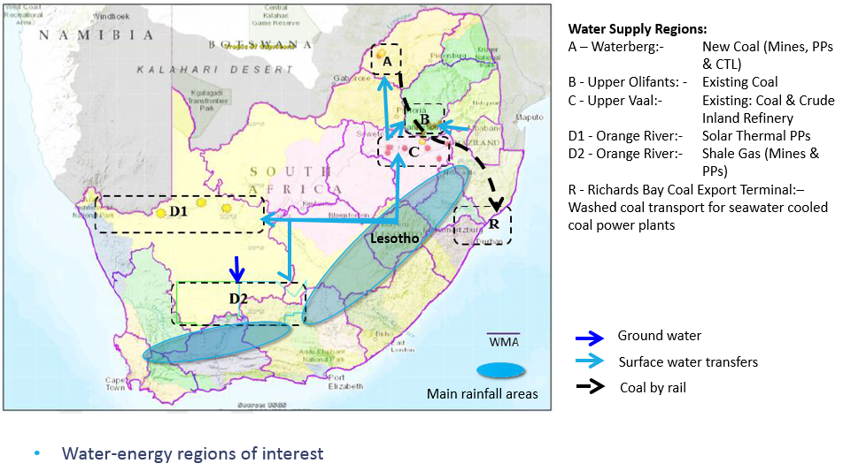
Project: Thirsty Energy Scope: National E3 Focus: Energy and Water Nexus focusing on Energy Supply (excl. biofuels) + Methodology Development Funders: World Bank Collaborators: Aurecon, Decisionware

Slide 29

Thank you!
brunomerven@gmail.com

